Slide 1

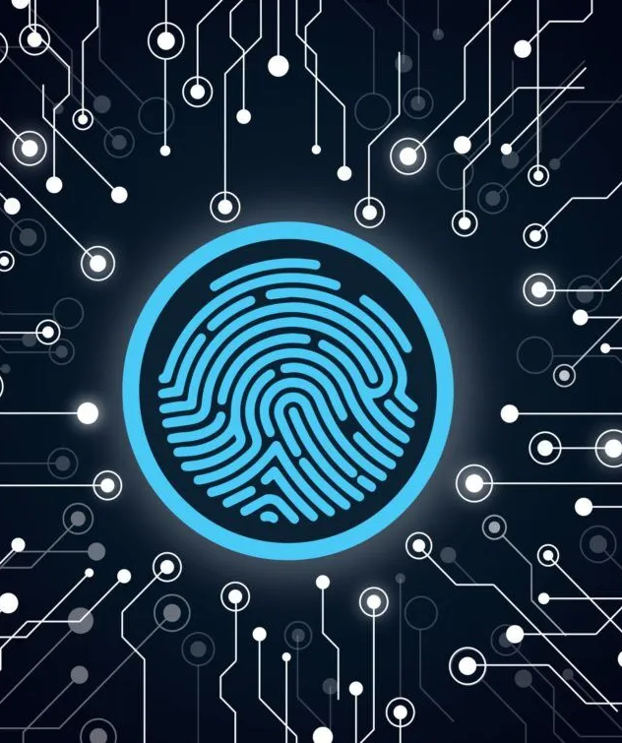

BIOMETRIC STUDENT ATTENDANCE
Presented by: GROUP 5

Slide 2
REQUIREMENTS GATHERING
Presented by: GROUP 5

Slide 3
OUTLINE
1
2
3
4
Introduction
Objective and Goal
Requirement gathering methods
Stakeholders
5
6
Gathered Requirements
Conclusion

Slide 4



1-INTRODUCTION
In today's tech-driven classrooms, wasting time on roll call is outdated. Biometric student attendance app streamlines attendance with secure fingerprint technology, freeing up valuable teaching minutes for educators. Let's explore key features that make this app user-friendly and adaptable for all schools, ultimately revolutionizing attendance tracking.

Slide 5
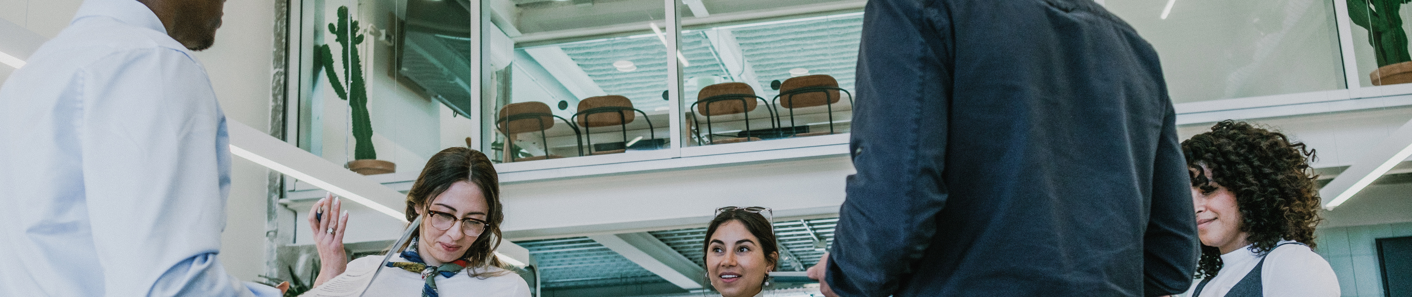
2-OBJECTIVES AND GOAL
Objective
The objective of this project is to develop a secure and user-friendly mobile application that leverages fingerprint recognition technology for student attendance tracking in educational institutions.
Goal
The goal of this project is to revolutionize attendance tracking in schools and contribute to a more efficient and effective learning environment.

Slide 6





3-STAKEHOLDERS
1
Internal stakeholders are individuals or groups that are directly associated with the project.
App development team
Educational institution
2
External stakeholders are individuals or groups that exist outside of the organization but have an interest or influence in the project's outcomes.
End users
Financial stakeholders

Slide 7

4-REQUIREMENTS GATHERING METHODS
brainstorming
surveys
Interviews
user persona

Slide 8
4.1-BRAINSTORMING
efficiency
Attendance should be quick (under 5 seconds per student).
our application should take in consideration multi-languages support,color blindness consideration.,
accessibility
user features
students registration, attendance recording using fingerprint, download and view the attendance records etc..
Implement a system to flag potential errors, such as unregistered fingerprints or duplicate scans.
accuracy

Slide 9


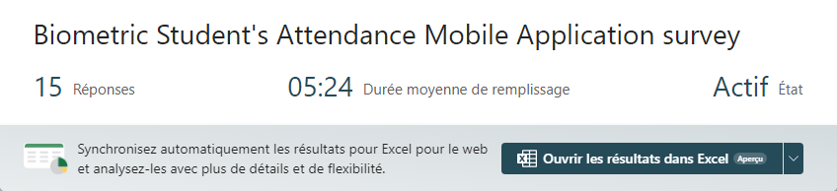
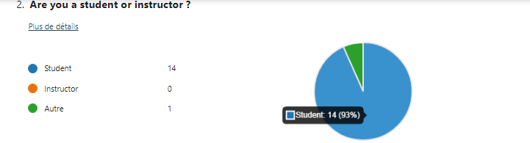
4.2-surveys
The following shows in detail what we got as answers and we noticed that people were very engage when filling out the form, in average 05:24 minutes to fill the form for 15 answers. Following are screenshots of the result.

Slide 10

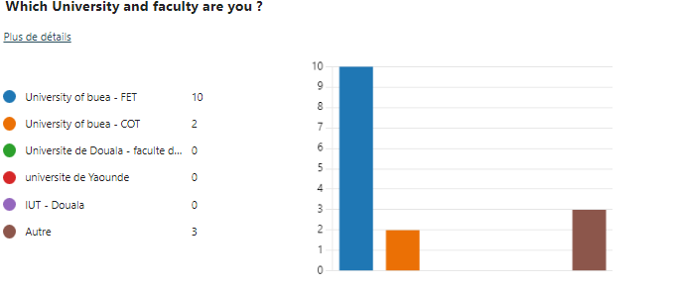

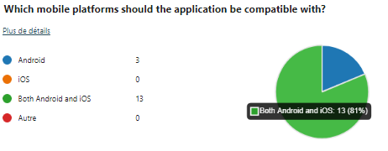

Slide 11
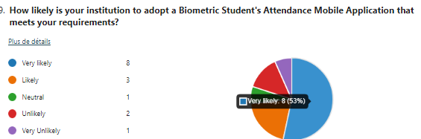
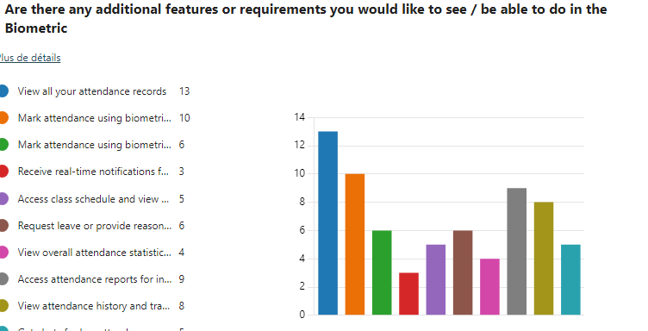

Slide 12



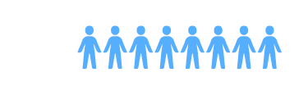
4.3-INTERVIEWS
80%
desires a reliable efficient , and secure biometric application that streamlines the process of taking attendance, eliminates errors, and provides real-time data.
20%
desires a biometric attendance application that deal with face recognition instead of fingerprint.

Slide 13



4.4-USER PERSONA
Our target audience is instructors who are frustrated with the time-consuming and error-prone process of traditional attendance methods. They crave a system that's quick, accurate, and provides real-time data to identify at-risk students. Ideally, this seamless solution would minimize disruption to the flow of their lessons.
Olivier
Wilson
instructor

Slide 14
5-GATHERED REQUIREMENTS
requirements from the interviews: timetable availability, attendance file, effective user experience, facial recognition, authentication system.
requirements from the surveys: low attendance alerts, view attendance records, request leave of absence, real-time notifications.
requirements from the brainstorming: log in, sign up, multi-language support, biometric authentication etc...

Slide 15
6-CONCLUSION
In conclusion, our requirement gathering for the biometric student attendance app identified key needs: faster attendance recording (under 5 seconds), security, and user roles (students scan, instructors manage sections, admins manage instructors). This paves the way for a user-friendly app that streamlines attendance and benefits all stakeholders in schools.

Slide 16

Thank you

